Slide 1


Department of Computer Science and Engineering
AI VOICE ASSISTANT FOR LEGAL INFORMATION
USING GEN AI
Ms. S.Nagomiya Assistant Professor
Murshid Ahmed S (210701171)
Nikhil P (210701179)
TEAM ID-B21A2425C29

Slide 2
Problem Statement and Motivation
Accessing legal information is often a daunting task, especially in regions where language barriers and complex legal jargon create significant obstacles. Traditional legal services demand time, effort, and financial resources, making them inaccessible to many. The lack of localized legal resources in multiple regional languages further exacerbates this issue, leaving underserved communities without the guidance they need. Motivated by the need to democratize access to legal information, our project aims to develop an AI-assisted chatbot that supports multiple regional languages and includes a voice assistant. This innovation seeks to break down these barriers, providing clear and accurate legal guidance to all, regardless of language or location. By making legal information more inclusive and user-friendly, we strive to empower individuals to navigate legal challenges with greater confidence and understanding.

Slide 3
Objectives
The primary objective of this project is to develop an AI-assisted chatbot that provides accurate and accessible legal information to users across different linguistic regions. The chatbot will be designed to support multiple regional languages and feature a voice assistant, enabling seamless interaction through both text and speech. By integrating natural language processing and machine learning, the chatbot will be capable of understanding and responding to diverse legal inquiries, offering personalized insights and guidance. This project aims to bridge the gap between legal resources and the public, ensuring that individuals from all backgrounds can easily access the legal information they need. Ultimately, the objective is to create a user-friendly, multilingual platform that democratizes legal knowledge, promotes legal literacy, and supports informed decision-making.

Slide 4
Abstract
This project presents the development of an AI-assisted chatbot designed to provide legal information in multiple regional languages, with a specific focus on English and Tamil. The chatbot leverages both text and voice interfaces, offering users the flexibility to interact with the system in their preferred mode. The system is built using a Python Flask backend and a React-based frontend, integrated with PyTorch-based neural networks for natural language processing (NLP). In the initial phase, the chatbot provides accurate and context-sensitive legal information, while in the second phase, it emphasizes enhanced voice output capabilities to improve accessibility for diverse user groups. By enabling seamless voice and text interactions, the project aims to democratize access to legal information, particularly for non-English speakers, thereby reducing language barriers and improving legal awareness in underserved regions.

Slide 5
Literature Survey
Paper title | Year of publishing | Name of the Journal | Methodology used | Advantages
A Novel Approach for Text Generation using RNN for Language Modeling | 2023 | ICIMIA | Recurrent Neural Networks (RNNs) for language modeling, leveraging word embeddings and sequence-to-sequence architecture to generate text. | RNNs offer strong contextual understanding by retaining information from previous words in a sequence, making them effective for language generation.
Construction Project Estimation with LSTM: Materials, Costs and Timelines | 2024 | IC3IoT | The methodology uses Long Short-Term Memory (LSTM) networks to predict construction project materials, costs, and timelines based on historical data. | The advantage is its ability to capture long-term dependencies, improving accuracy in complex project estimations.

Slide 6
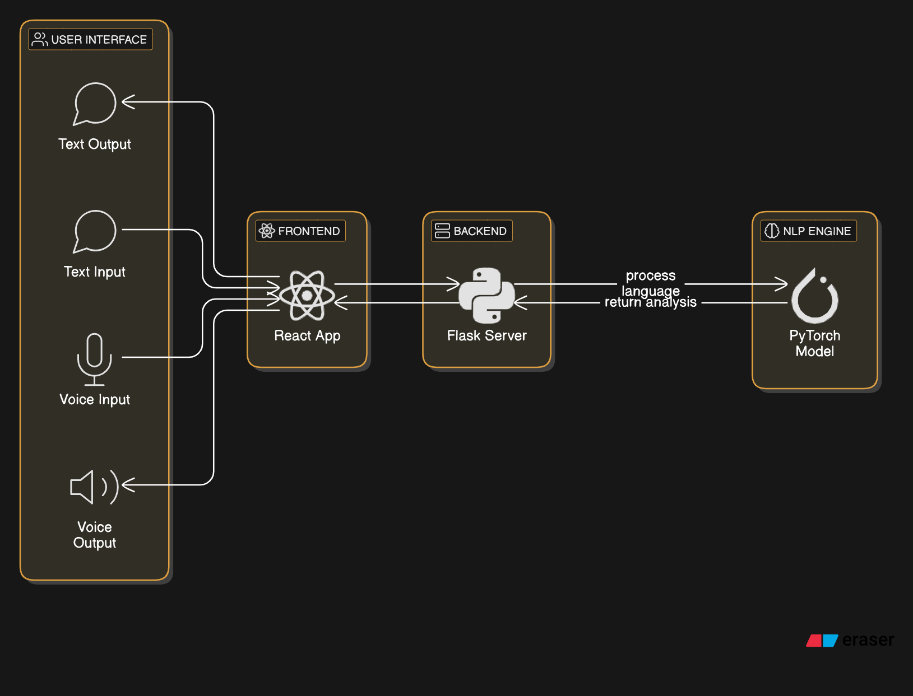
System Architecture

Slide 7
List of Modules
Data pre-processing module
Intents integration module
Tokenization module
Training and Testing data module
Text and voice output module

Slide 8
Functional Description for each modules
Data pre-processing module: Cleans, normalizes, and translates legal data to ensure accurate handling of English and Tamil text for the chatbot.
Intents integration module: Maps user inputs to predefined legal intents for both English and Tamil queries, enabling context-aware responses.
Tokenization module: Breaks down user queries into manageable tokens for efficient processing in both languages.
Training and Testing data module: Utilizes labeled legal data in English and Tamil to train the chatbot for accurate legal responses, followed by testing to evaluate performance.
Text and voice output module: Generates the chatbot’s response in both text and synthesized voice formats for English and Tamil, providing multilingual interaction.

Slide 9
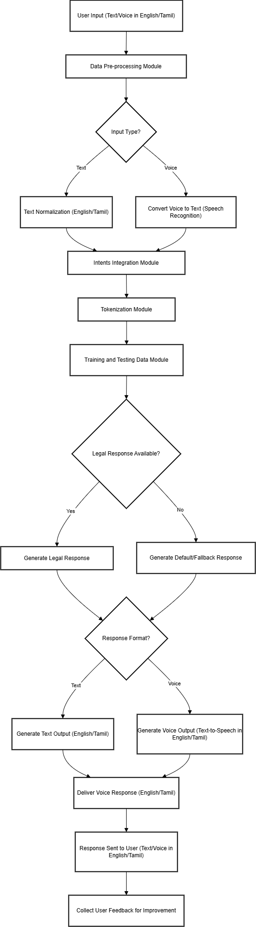
Activity Diagram

Slide 10
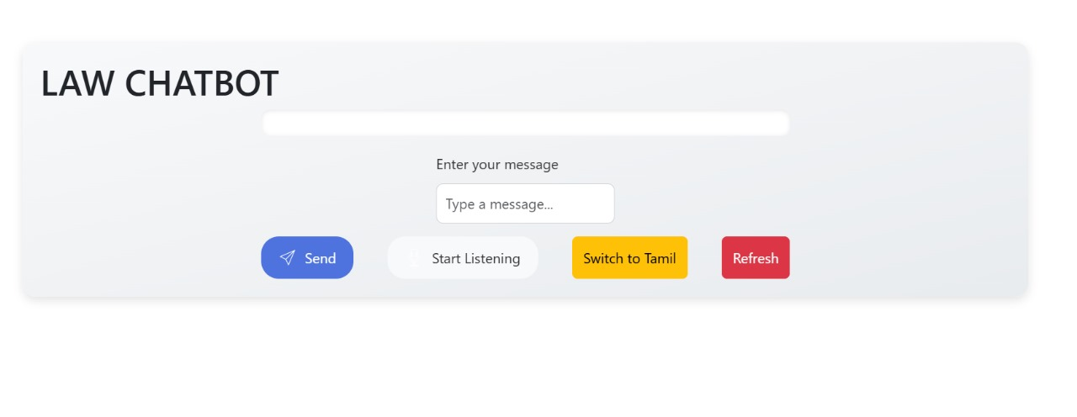
Implementation & Results of First Module

Slide 11
Conclusion & Work for Phase II
Phase 1 successfully delivers a text-based lawyer chatbot in English and Tamil, capable of processing legal queries, identifying intents, and providing accurate responses. This phase establishes a solid foundation for multilingual legal support and prepares the system for further optimization based on user feedback.
Phase 2 will introduce voice output in both languages by integrating text-to-speech and enhanced speech recognition. The focus will be on providing clear, natural voice responses and improving user interaction through seamless voice and text transitions, with testing to ensure a smooth user experience.

Slide 12
References
P. Kumar, S. Manikandan, and R. Kishore, ”A Novel Approachfor Text Generation using RNN for Language Modeling,” 20233rd International Conference on Innovative Mechanisms forIndustry Applications (ICIMIA), Bengaluru, India, 2023, pp.278-282. doi10.1109/ICIMIA60377.2023.10425798.
K. Deepak Kumar, P. Kumar, G. Saravana Gokul, J. Kabilan,G. Dhanush, and S. Senthil Pandi, ”Construction ProjectEstimation with LSTM: Materials, Costs and Timelines,” 2024International Conference on Communication, Computing andInternet of Things (IC3IoT), Chennai, India, 2024, pp. 1-6. doi:10.1109/IC3IoT60841.2024.10550246.

Slide 13
Paper Publication Status
PUBLICATION STATUS : Submitted for Approval
TITLE OF THE PAPER : AI VOICE ASSISTANT FOR LEGAL INFORMATION
USING GENAI
AUTHORS : Murshid Ahmed S, Nikhil P, Nagomiya S
NAME OF THE CONFERENCE : InCACCT-2025-3RD International Conference on Advancement in Computation & Computer Technologies
DATE OF PRESENTATION : 17 April 2025

Slide 14
Thank You

